Slide 1
Uml
Restaurant()
IceCreamStand()
_name
-cuisine_type
flavors[]
+ __init__(self,_name,cuisine_type)
+ describe_restaurant(self)
+ open_restaurant(self)
+ __init__(self,_name,cuisine_type="IceCream")
+ flavorsTip(self)

Slide 2
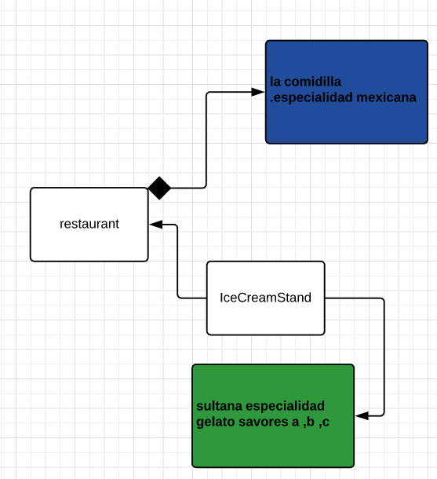

Slide 3
User()
Admn()
keyUs
_name
_lastName,
_city
Privileges[]
+ __init__(self,keyUs,_name,_lastName,_city)
+ show_privileges(self)
+ __init__(self,keyUs,_name,_lastName,_city)
+ describe_user(self)
+ greet_user(self)

Slide 4
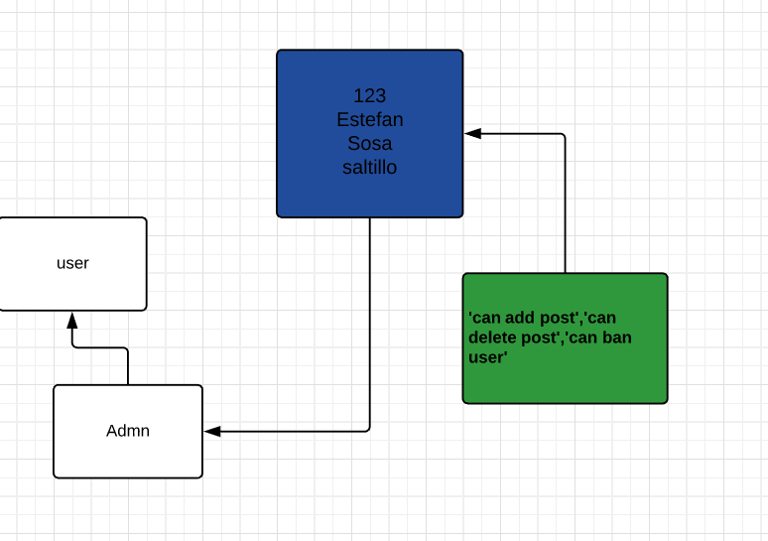

Slide 5
User()
- keyUs _name _lastName, _city
+ __init__(self,keyUs,_name,_lastName,_city) + describe_user(self) + greet_user(self)
Admn()
Privileges : []
+ __init__(self,keyUs,_name,_lastName,_city) + show_privileges(self)
priv()
Privileges
+ def __init__(self,keyUs,_name,_lastName,_city)

Slide 6
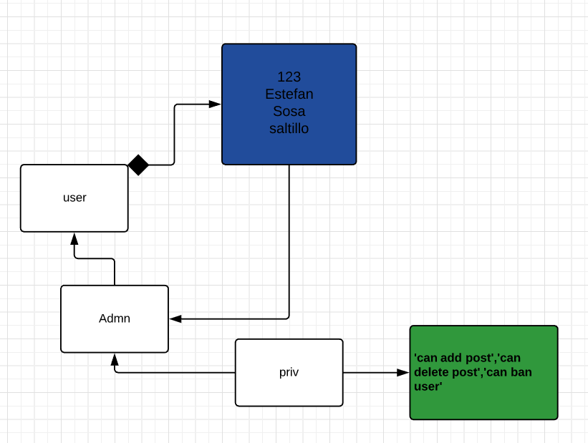

Slide 7
Battery()
battery_size= 70
+ __init__(self,battery_size= 70) + describe_battery(self) + get_range(self) + upgrade_battery(self)
car()
Make Model year
+ def __init__(self,make,model,year) + get_descriptive_name(self) + read_odometer(self) + update_odometer(self,mileage) + increment_odometer(self,miles)
ElectricCar()
batteryy = Battery()
+ def __init__(self, make, model, year)

Slide 8
